Slide 1
IoT based LPG leakage and level detection and using Thing Speak platform
Guide
Mrs.Vijayarani T
TeamMates
M Eranna 3BR21EC083
Matam Muddu Veeraiah 3BR21EC102
Balija Ajith Kumar 3BR21EC025
Madamanchi Bharath 3BR21EC092

Slide 2
Table Of Contents
Introduction
Objective
Block Diagram
Working Module
Requirements (Hardware & Software)
Output Screens
Future Scope
Conclusion

Slide 3
INTRODUCTION
Widespread Use: LPG is widely used in households, industries, and commercial establishments due to its high calorific value and convenience.
Manual Monitoring Challenges: Traditional methods of manually monitoring LPG levels are often inconvenient and prone to oversight, leading to potential supply disruptions.
Uninterrupted Supply: Ensuring an uninterrupted LPG supply is a significant challenge, especially when relying on manual monitoring that may fail to detect low gas levels in time.
Safety Hazards: Accidental LPG leaks present serious safety risks, potentially leading to catastrophic incidents if not detected promptly.
Emergency Situations: Traditional methods often fail to address emergency situations effectively, such as gas leaks or sudden depletion of gas.
Need for Automation: There is a growing need for reliable, automated solutions to monitor LPG levels and detect leaks, ensuring both safety and continuous supply.

Slide 4
OBJECTIVE
· Aim: Develop an IoT-based system for efficient and safe management of LPG cylinders.
· Monitoring LPG Levels: Uses a pressure sensor to monitor the gas levels in the cylinder.
· Leakage Detection: Detects LPG gas leakage using a gas sensor to enhance safety.
· Real-Time Alerts: Provides instant notifications and alerts to users in case of issues, such as leakage or low gas levels.
· Buzzer Notification: Alerts users with a buzzer for immediate attention.
· Automated Booking: Automates the LPG cylinder booking process via the ThingSpeak platform using the ESP8266 Wi-Fi module.
· Safety & Convenience: Ensures uninterrupted gas supply, reduces manual intervention, minimizes risks, and improves user experience.

Slide 5
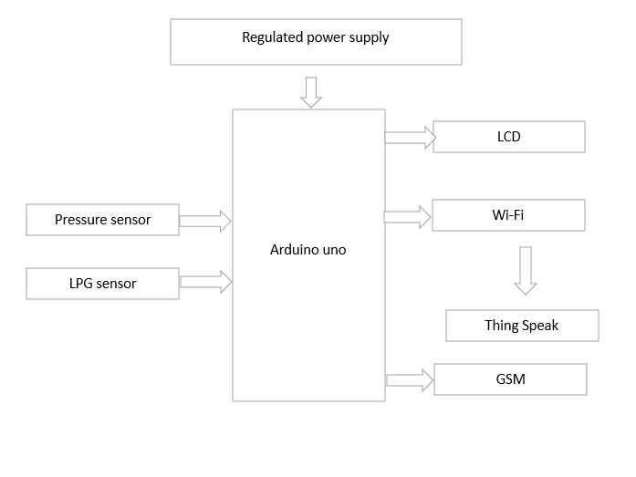
BLOCK DIAGRAM

Slide 6
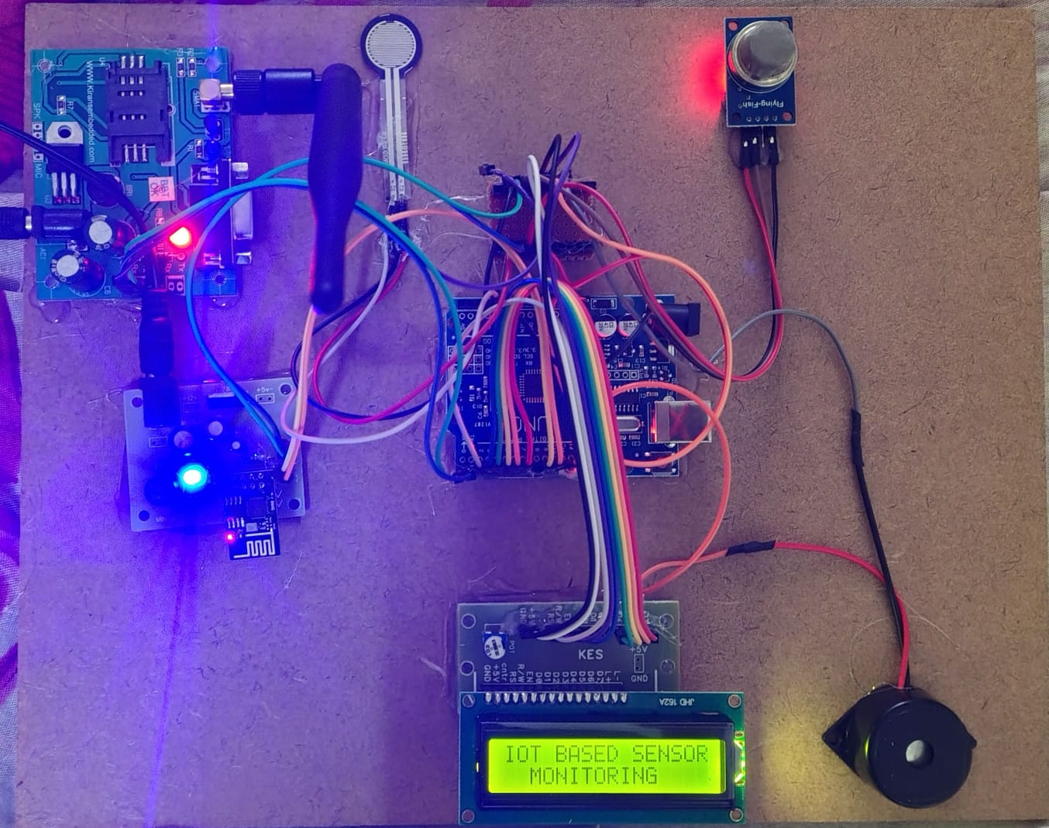
Working Module

Slide 7
Working
Startup:
  The Arduino initializes the pressure sensor and ESP8266 Wi-Fi module during startup.
  The system connects to the configured Wi-Fi network and ThingSpeak platform.
Gas Level Monitoring:
  The pressure sensor continuously measures the weight of the LPG cylinder.
  The Arduino processes the data and calculates the remaining gas level based on the weight.
Threshold Detection:
  The gas level is compared with a predefined threshold and leakage detection.
  If the level falls below the threshold, the system triggers an action.
Data Transmission:
  The ESP8266 Wi-Fi module sends the gas level data to the ThingSpeak cloud platform.
  ThingSpeak processes the data and sends a booking request to the LPG supplier.
Alert Notification:
  If the gas level is critically low, the system triggers a buzzer alert for immediate attention.
  The user is notified via the ThingSpeak platform or a mobile application.
Automatic Booking:
The ThingSpeak platform sends a preconfigured booking request to the supplier. And send sms.

Slide 8
REQUIREMENTS
HARDWARE
SOFTWARE
ARDUINO UNO
PRESSURE SENSOR
LPG SENSOR
LCD
WIFI
GSM
THING SPEAK
REGULATED POWER SUPPLY
ARDUINO IDE
EMBEDDED C PROGRAMMING

Slide 9
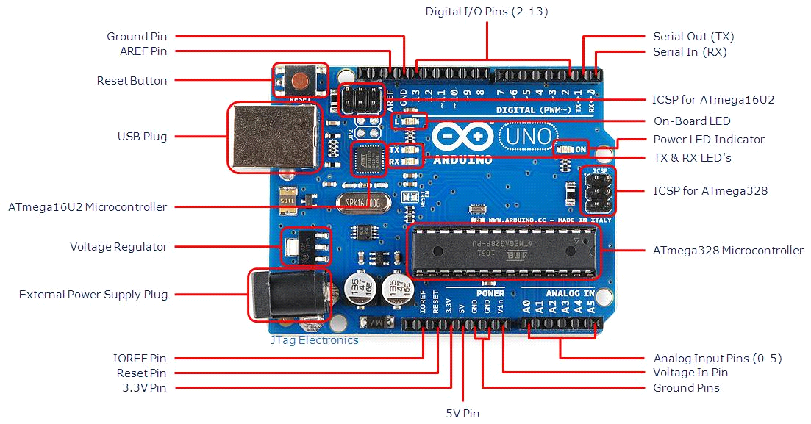
ARDUINO UNO
Popular and Beginner-Friendly: The Arduino Uno is the most common and widely used version, making it a great choice for beginners.
Latest Revision (Rev3/R3):
The most recent version, Rev3 (R3), includes improvements and additional features over previous revisions.

Slide 10
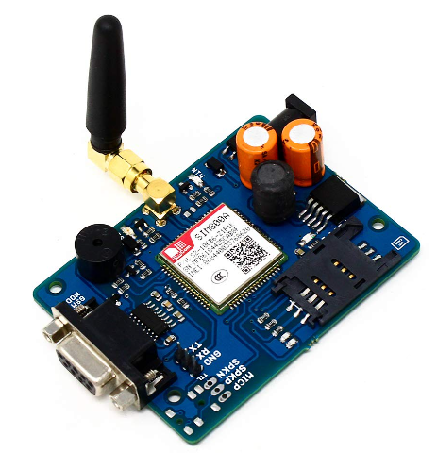
GSM
A GSM module is a device that enables communication between a microcontroller and a mobile network, allowing SMS, voice calls, and data transfer. It requires a SIM card and uses serial communication to interact with microcontrollers like Arduino.

Slide 11
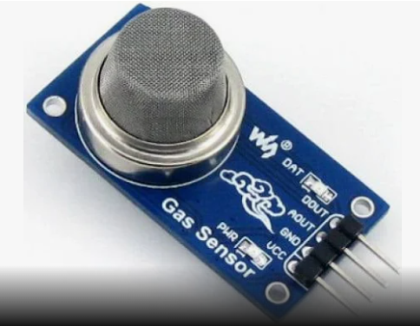
GAS SENSOR
A gas sensor is a device that detects the presence and concentration of gases in the environment, such as LPG, methane, or carbon monoxide. It converts the gas concentration into an electrical signal that can be read by a microcontroller for monitoring or alert purposes.

Slide 12
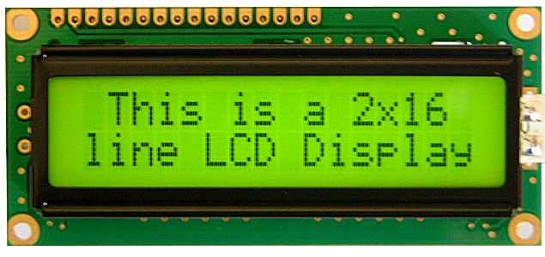
LCD
An LCD display is a flat-panel screen that uses liquid crystals to display text. It is commonly used in electronic projects to visually present data from a microcontroller or sensor.

Slide 13
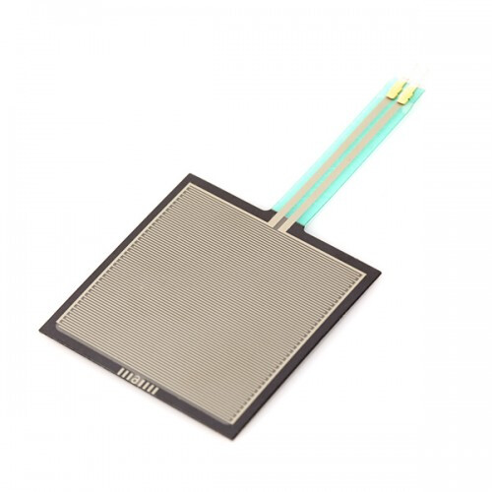
PRESSURE SENSOR
A pressure sensor is a device that measures the pressure of gases or liquids and converts it into an electrical signal. It is commonly used in applications like monitoring fluid levels, weather systems, and industrial processes.

Slide 14
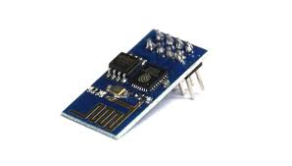
WIFI
The ESP8266 Wi-Fi module is a low-cost wireless communication device that enables microcontrollers to connect to Wi-Fi networks. It allows IoT devices to send and receive data over the internet, making it ideal for remote monitoring and control applications.

Slide 15
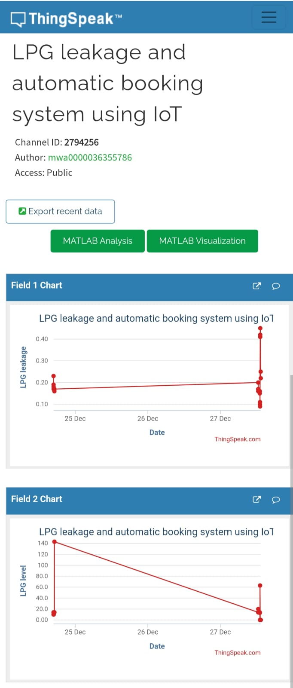
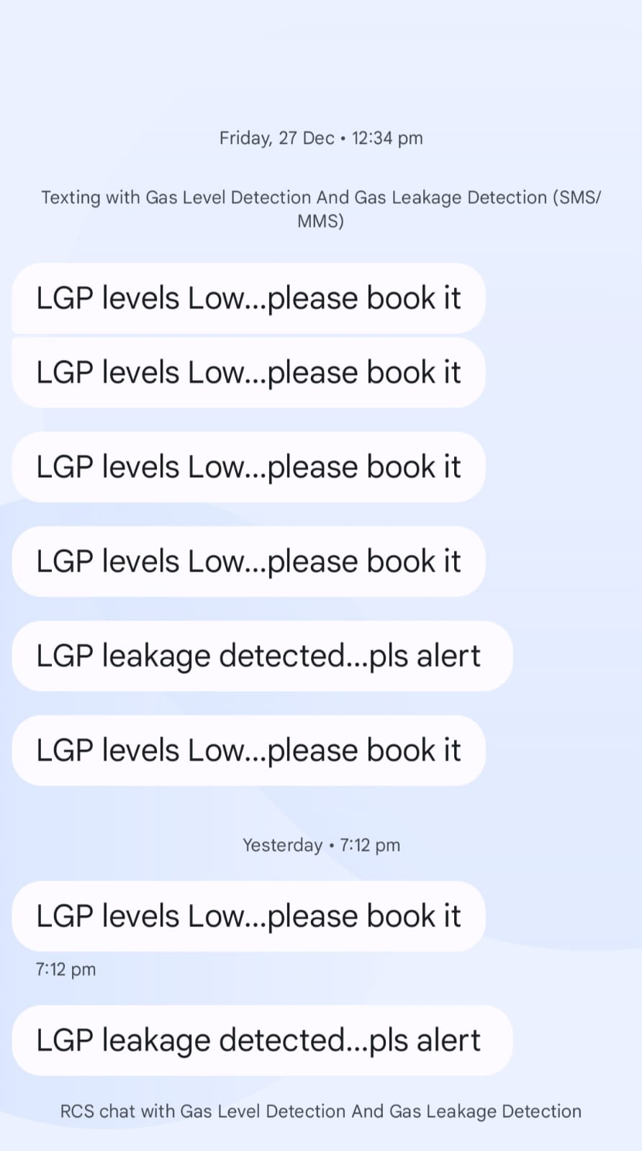
Output Screens

Slide 16
FUTURE SCOPE
AI-Driven Analytics: Integrating AI can predict gas consumption trends and optimize refill schedules, improving efficiency and reducing waste.
Mobile App Integration: A mobile app can offer real-time monitoring and control, enhancing user interaction and convenience.
Broader Application: Expanding the system to industrial and commercial LPG setups extends its benefits to larger-scale operations.
Sustainability and Automation: Incorporating solar power and smart home integration can boost sustainability, automation, and safety, making the system more versatile and future-ready.

Slide 17
CONCLUSION
The IoT-based LPG Leakage and Level Detection System with auto-booking offers an efficient and user-friendly solution for managing LPG cylinders. Using advanced sensors and IoT technology, it ensures real-time monitoring of gas levels and detects leaks, enhancing safety and convenience. Integration with the ThingSpeak platform automates refill bookings, reducing manual effort and ensuring an uninterrupted supply. The system also includes buzzer alerts and SMS notifications for timely gas leakage warnings, minimizing risks. This comprehensive approach simplifies cylinder management and addresses safety concerns, demonstrating the potential of IoT to improve daily life.

Slide 18
REFERENCES
[1] Kumar Keshamoni, Sabbani Hemanth, “Smart Gas Level Monitoring, Booking and Gas Leakage Detector over IoT”, IEEE 7th International Advance Computing Conference,2017.
[2] Chaitali Bagwe, Vidya Ghadi, Vinayshri Naik, Neha Kunte, “IOT Based Gas Leakage Detection System with Database Logging, Prediction and Smart Alerting- Review”,March 2018.
[3] B. D. Jolhe, P. A. Potdukhe, N. S. Gawai, “Automatic LPG Booking, Leakage Detection And Real Time Gas Measurement Monitoring System”, International Journal of Engineering Research & Technology
(IJERT) ,April 4, 2013.
[4] R.Naresh Naik, P.Siva Nagendra Reddy, S.Nanda Kishore, K.Tharun Kumar Reddy. “Arduino Based LPG gas Monitoring & Automatic Cylinder booking with Alert System”, IOSR Journal of Electronics and
Communication Engineering (IOSR-JECE), August 2016.
[5] S.Rajitha, T.SWAPNA, “A Security Alert System Using Gsm For Gas Leakage”, International Journal Of VLSI And Embedded Systems,2012.

Slide 19
THANK YOU

